Slide 1


Optics Laboratory
2nd Grade - 1st Semester
2018/2019
Instructors
Assist. Prof. Dr. Sabah Ibrahim
Assist. Lect. Muhanned Jamal
Assist. Lect. Najwa Ibrahim

Slide 2
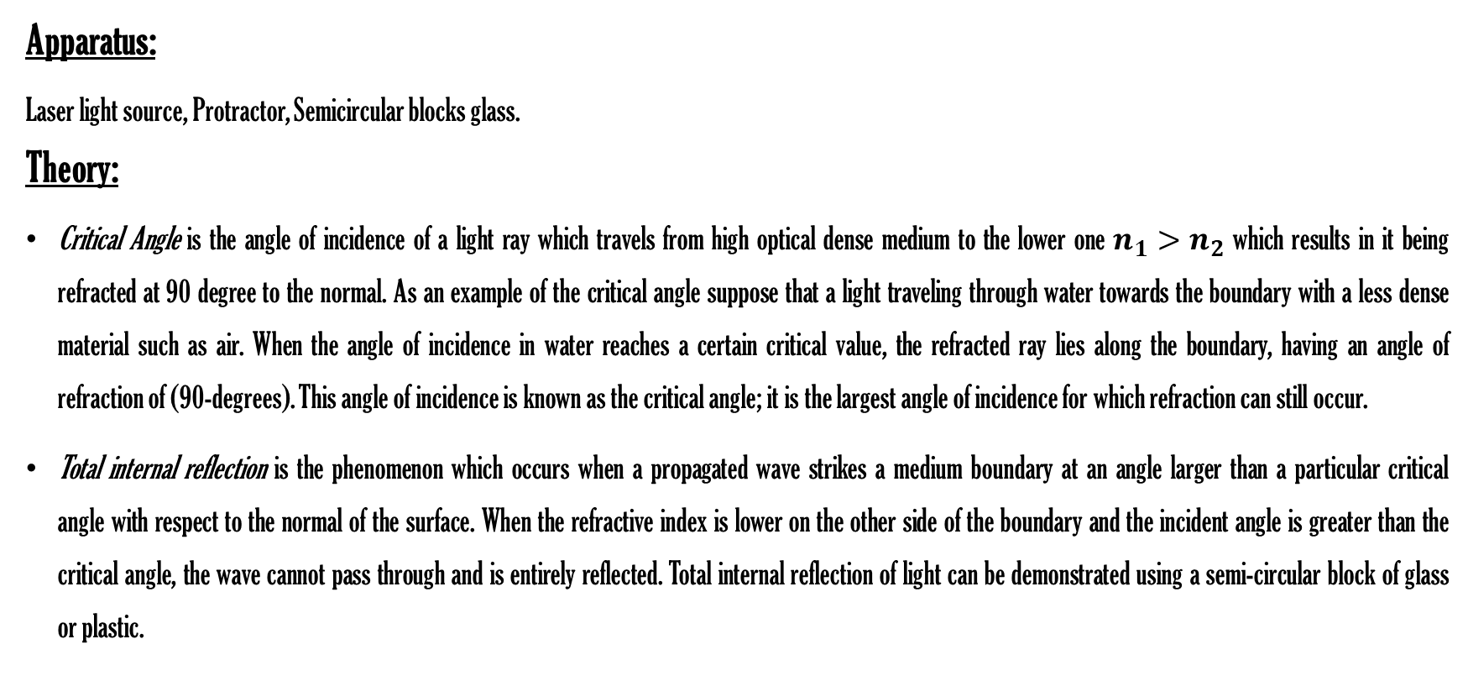
Experiment Five
Critical Angle and Total Internal Reflection
Apparatus:
Laser light source, Protractor, Semicircular blocks glass.
Theory:
Critical Angle is the angle of incidence of a light ray which travels from high optical dense medium to the lower one $n_{1}>n_{2}$ which results in it being refracted at 90 degree to the normal. As an example of the critical angle suppose that a light traveling through water towards the boundary with a less dense material such as air. When the angle of incidence in water reaches a certain critical value, the refracted ray lies along the boundary, having an angle of refraction of (90-degrees). This angle of incidence is known as the critical angle; it is the largest angle of incidence for which refraction can still occur.
Total internal reflection is the phenomenon which occurs when a propagated wave strikes a medium boundary at an angle larger than a particular critical angle with respect to the normal of the surface. When the refractive index is lower on the other side of the boundary and the incident angle is greater than the critical angle, the wave cannot pass through and is entirely reflected. Total internal reflection of light can be demonstrated using a semi-circular block of glass or plastic.

